Slide 1




Revolutionizing Recruitment: Enhanced Machine Learning Models for Bias Mitigation and Efficiency
International Business Analytics Conference
8th May 2025

Slide 2
AGENDA
Introduction & Research Objectives
Key Results & Model Performance
01
04
02
Dataset & Preprocessing
05
Discussion, Challenges and Practical Implications
03
Machine Learning Models & Fairness Techniques
06
Conclusion & Future Works

Slide 3

Problem Statement
While machine learning has improved recruitment accuracy, many models overlook critical aspects like fairness, interpretability, and ethical accountability. This can lead to biased outcomes and a lack of transparency, especially when black-box models inherit societal inequalities or violate compliance standards.
Objective
Significance
Research Question
To develop and evaluate a comprehensive machine learning framework for recruitment that balances predictive performance with fairness, transparency, and ethical responsibility.
Bridges the gap between accuracy and responsible AI in recruitment by integrating fairness-aware algorithms and explainability tools, for both scholars and HR practitioners.
How can machine learning models be enhanced to optimize recruitment decisions while ensuring fairness, transparency, and efficiency?

Slide 4


Research Question
Primary:
How can machine learning models be enhanced to optimize recruitment decisions while ensuring fairness, transparency, and efficiency?
Sub questions:
1) Which candidate features are most predictive of hiring outcome?
2) How do traditional, ensemble, and deep learning models compare in terms of predictive accuracy and fairness?
3) Can fairness-aware algorithms effectively mitigate bias in hiring predictions?
4) How can SHAP and LIME enhance the interpretability of model decisions for HR professionals.

Slide 5

Literature Review
Fairness not addressed in ML hiring
Implemented Exponential Gradient via Fairlearn to enforce demographic parity
Barocas, S., Hardt, M., & Narayanan, A. (2016)
2. Cowgill, B., Dell’Acqua, F., & Deng, S. (2018)
No model explainability in decision pipelines
Integrated SHAP for global feature importance and LIME for local interpretation
3. Peña et al. (2023)
4. Al-Quhfa, S., et al. (2023)
Ethics, compliance, and bias often ignored
Designed a responsible AI framework balancing performance with fairness and transparency
5. Zhang, Y. & Chu, M. (2023)
6. Hasan, M. (2023)
Limited modelling approach
Evaluated multiple ML models including DNN, CatBoost, XGBoost, and SVM for robust comparisons
7. Haque, A., et al. (2022)
8. Tasheva, S., & Karpovich, V. (2024)

Slide 6


Dataset Overview – Structure & Overview
Dataset Source: recruitment.csv (Kaggle)
1,500 candidate profile & 9 features
Feature | Description | Data Type
Age | Age of the Candidate | Numerical
Experience Years | Number of years of professional experience
Interview Scores | Score achieved by the candidate in the interview process
Skill Score | Assessment score of candidate’s technical skills
Personality Score | Evaluation score of the candidate’s personality traits
Gender | 0: Male, 1: Female | Categorical
Education Level | 1: Bachelor’s (Type 1), 2:Bachelor’s (Type 2), 3: Master’s, 4: PhD
Recruitment Strategy | 1: Aggressive, 2: Moderate, 3: Conservative
Hiring Decision | 0: Not Hired, 1: Hired

Slide 7
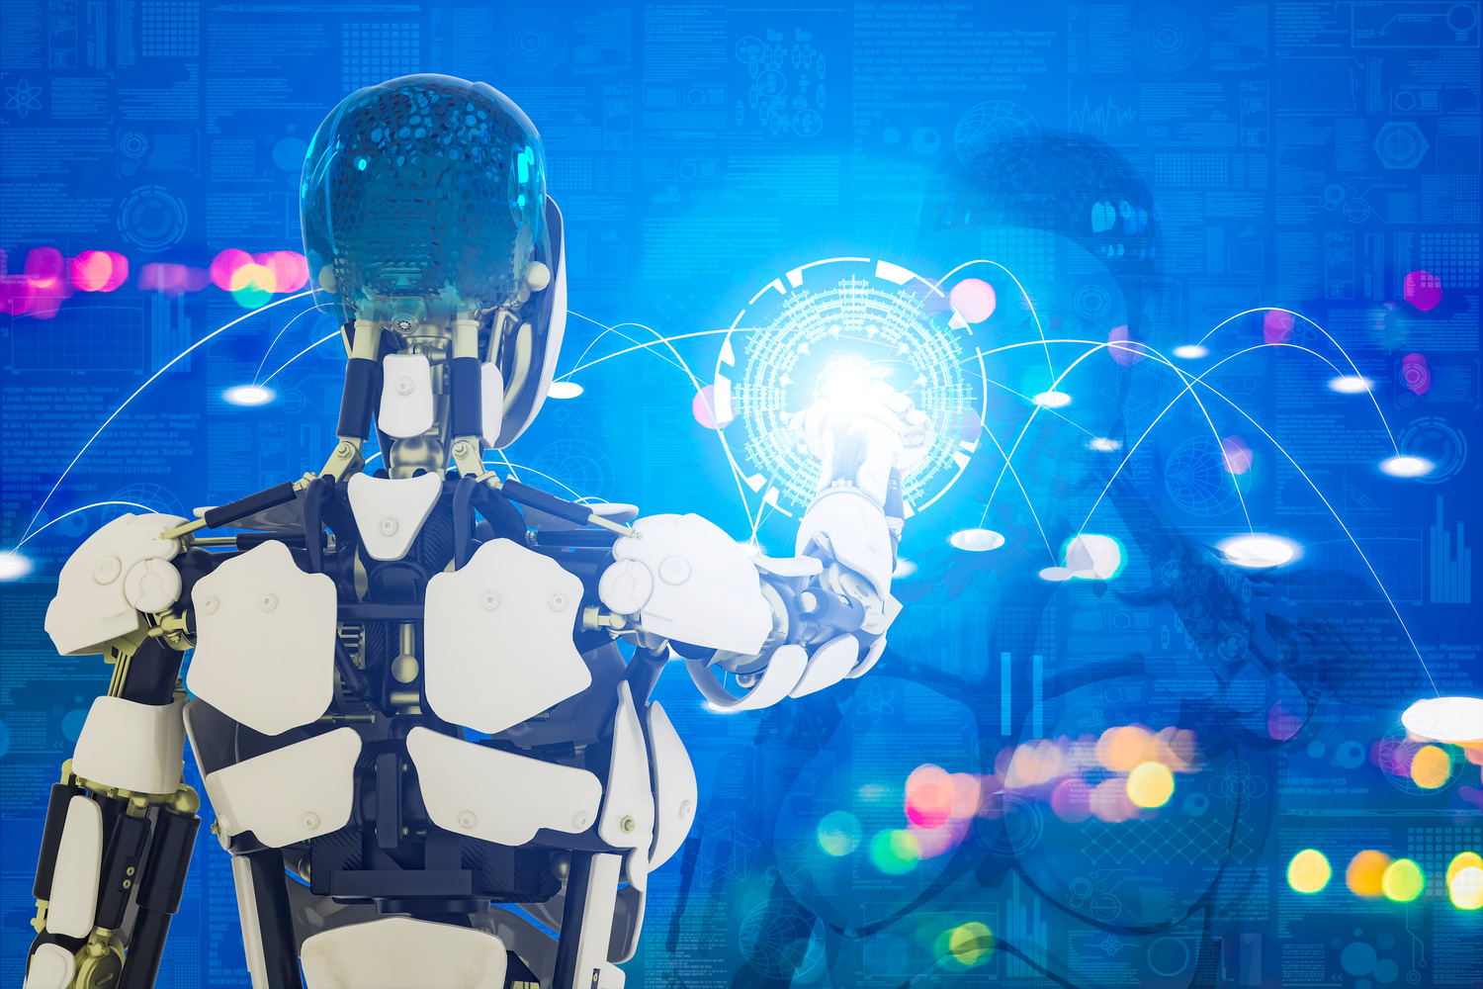

Model Explainability
Encoding Categorical Variables
Handling
Missing
Values &
Outliers
Fairness-Aware Training
Methodology
Modelling Techniques
Feature
Scaling
Hyperparameter Tuning
Cross Validation & Data Splitting
References:
(Barocas, Hardt, & Narayanan, 2019).

Slide 8
Dataset Demographic & Distribution
Gender Distribution
Education Distribution

Slide 9
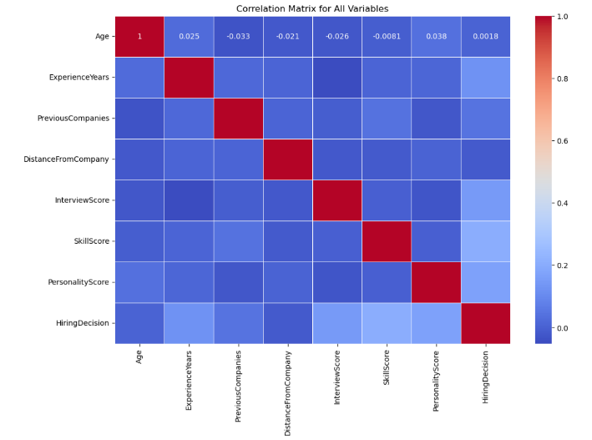
Feature Correlations
Features | Correlation Score
SkillScore | 0.2037
PersonalityScore | 0.1692
InterviewScore | 0.1461
ExperienceYears | 0.1225
PreviousCompanies | 0.0441
Age | 0.0185
DistanceFromCompany | -0.0168

Slide 10

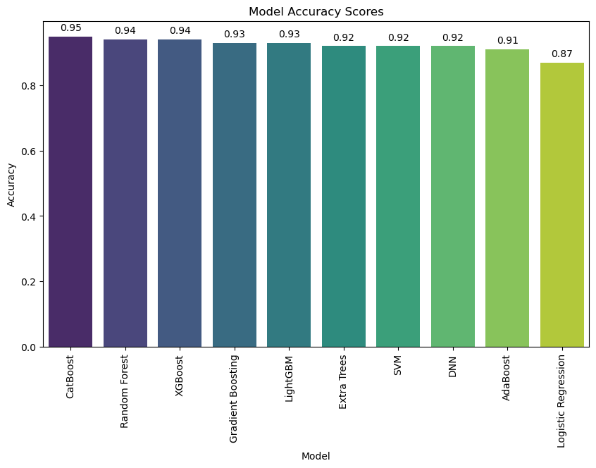

Model Accuracy Scores

Slide 11
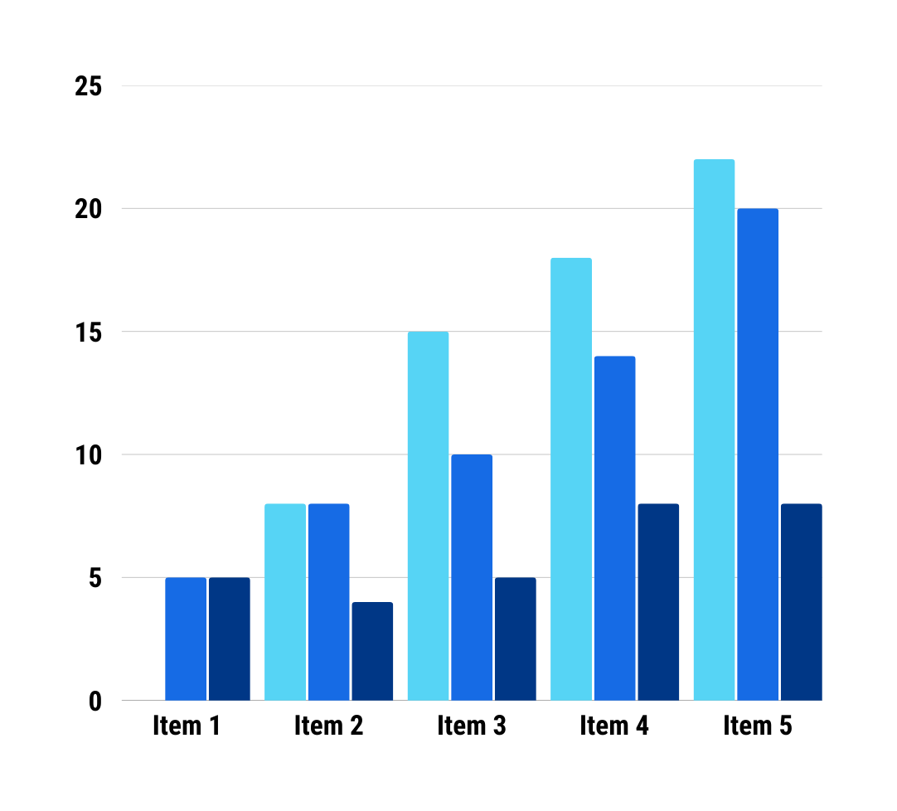
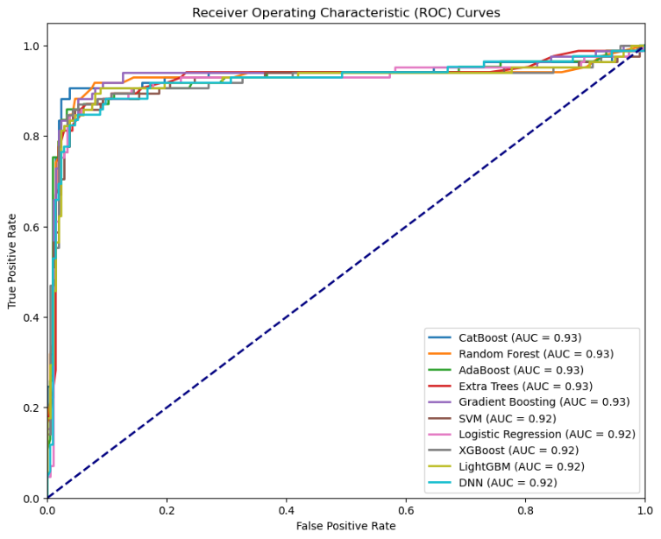
ROC-AUC Evaluation

Slide 12

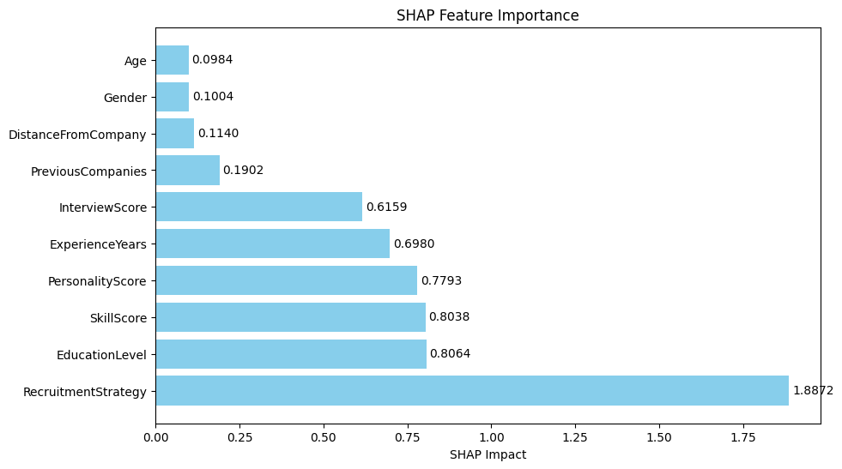
Metric | Before Mitigation | After Mitigation
Demographic Parity Difference (DPD) | 0.0142 | 0.0100
Equalized Odds Difference (EOD) | 0.0414 | 0.0300
Accuracy (Female Candidates) | — | 93.24%
Accuracy (Male Candidates) | — | 88.16%
Key Findings
Superior Model Performance: CatBoost Leads
Sensitive Attributes Had Minimal Impact
CatBoost achieved the highest predictive performance with 95.4% accuracy and 0.93 AUC score.
Age and Gender showed minimal predictive importance, supporting fairness objectives.
Effective Bias Mitigation through Fairness Constraints
Validated Model Stability with Hyperparameter Tuning
Bias mitigation using Exponentiated Gradient effectively reduced demographic disparities without major accuracy loss.
Hyperparameter tuning confirmed the models’ robustness, with minimal performance changes post- optimization.
Key Drivers of Hiring Decision
Building Ethical and Transparent Recruitment AI
Model | Before Tuning | After Tuning (GridSearchCV) | After Tuning (RandomSearch)
CatBoost | 0.9533 | 0.9542 | 0.9542
XGBoost | 0.9400 | 0.9292 | 0.9292
Random Forest | 0.9400 | 0.9242 | 0.9225
Logistic Regression | 0.8667 | 0.8657 | 0.8558
SHAP analysis revealed Recruitment Strategy, Education Level and Skill Score as the most influential features.
Combining ensemble methods, fairness algorithms, and explainability tools creates responsible, transparent AI hiring systems.
References:
(Meijerink, Bondarouk, & Lepak, 2021)

Slide 13




Practical Implications
Streamlined Hiring Workflows
Bias Reduction in Recruitment
Goal:
Strategic Talent Acquisition
Regulatory and Ethical Compliance
Enhanced Decision Transparency
References:
(Peña et al.), (Mehrabi et al., 2021)

Slide 14



Challenges Faced
High Performance Overlap
Hyperparameter
Tuning
Contradictions between SHAP & LIME

Slide 15

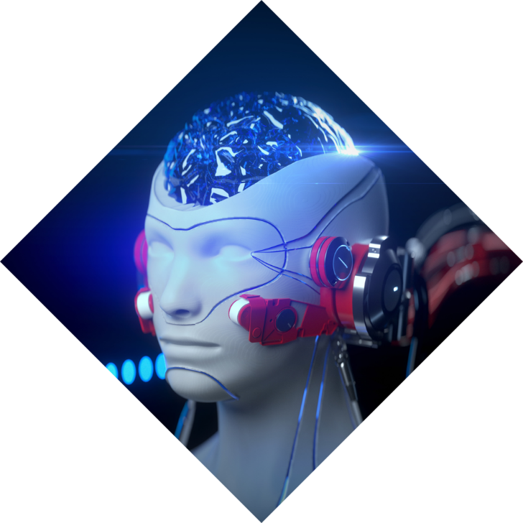
Conclusion
Future Works
CatBoost achieved highest performance:
• Accuracy: 95.4% • ROC-AUC: 0.93
• Balanced Precision/Recall
1
Broader Algorithmic Exploration
2
Expanded Feature Sets
3
Exponentiated Gradient reduced gender bias
Greater Interpretability in DNNs
4
Real World Deployment & Feedback Loops
SHAP & LIME enabling trustworthy, compliant, and equitable recruitment decisions.
5
Cross Context Generalization

Slide 16








Future Research Direction
Real-World System Deployment
Implement models in live recruitment workflows and monitor outcomes to create human-AI collaborative hiring systems.
Expand Data Diversity
Incorporate larger, multi-source datasets across industries and geographies to improve generalization.
Enhance Interpretability for Deep Learning
Apply techniques like Integrated Gradients and Attention-based Interpretability for better neural network transparency.
Integrate Behavioral & Unstructured Data
Include psychometric tests, resume texts, and video interviews for richer candidate profiles.
Deeper Fairness Modelling
Explore intersectional fairness (gender + ethnicity) and longitudinal fairness (long-term impact analysis).

Slide 17





Thank You
For your attention! If you have any questions or would like to discuss further, please feel free to reach out.
itaumai@northwood.edu
yenugah80@northwood.edu
ravim@northwood.edu
Midland, Michigan

Slide 18


References
[1] Barocas, S., Hardt, M., & Narayanan, A. (2019). Fairness and machine learning: Limitations and opportunities. fairmlbook.org. https://fairmlbook.org
[2] Raji, I. D., Smart, A., White, R., Mitchell, M., Gebru, T., Hutchinson, B., ... & Barnes, P. (2020). Closing the AI accountability gap: Defining an end-to-end framework for internal algorithmic auditing. In Proceedings of the 2020 Conference on Fairness, Accountability, and Transparency (pp. 33–44). https://doi.org/10.1145/3351095.3372873
[3] Lundberg, S. M., & Lee, S.-I. (2017). A unified approach to interpreting model predictions. In Advances in Neural Information Processing Systems (NeurIPS), 30. https://proceedings.neurips.cc/paper_files/paper/2017/file/8a20a8621978632d76c43dfd28b67767-Paper.pdf
[4] Peña, A., Serrano, A., Martinez, J., & Riera, P. (2023). Human-centric multimodal machine learning: Recent advances and testbed on AI-based recruitment. Journal of Artificial Intelligence Research, 68, 123–145. https://doi.org/10.1613/jair.1.13471
[5] Mehrabi, N., Morstatter, F., Saxena, N., Lerman, K., & Galstyan, A. (2021). A survey on bias and fairness in machine learning. ACM Computing Surveys, 54(6), 1–35. https://doi.org/10.1145/3457607
[6] Raji, I. D., & Buolamwini, J. (2019). Actionable auditing: Investigating the impact of publicly naming biased performance results of commercial AI products. In Proceedings of the 2019 AAAI/ACM Conference on AI, Ethics, and Society (AIES) (pp. 429–435). https://doi.org/10.1145/3306618.3314244

